Slide 1

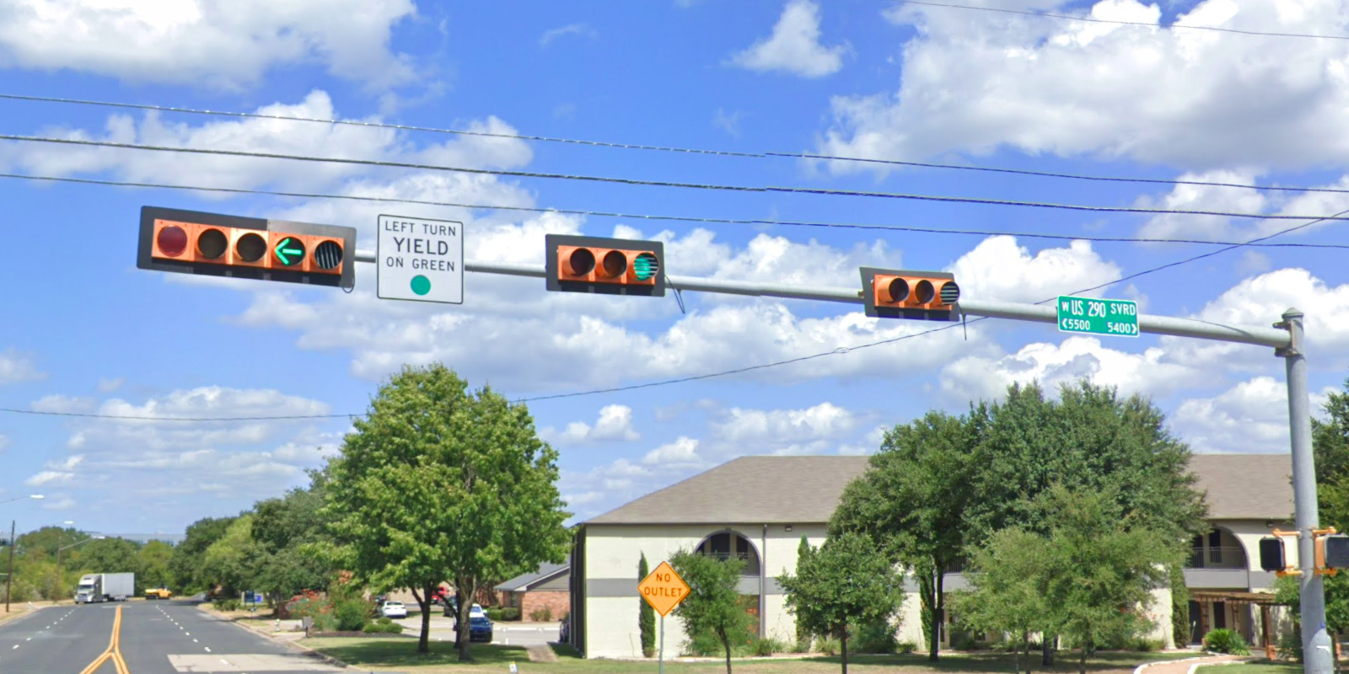
Austin Transportation Department Signs Work Orders
Created By: Susanne Gov Created Date: 2020-08-10 Location Name: US 290 HWY SVRD / INDUSTRIAL OAKS BLVD Intersection ID: 5147034 Cardinal Direction: N Work Order ID: SG-20710
Sign Type | Install/Remove
Left Turn Yield On Green | Install
Street Name Sign | Install

Slide 2
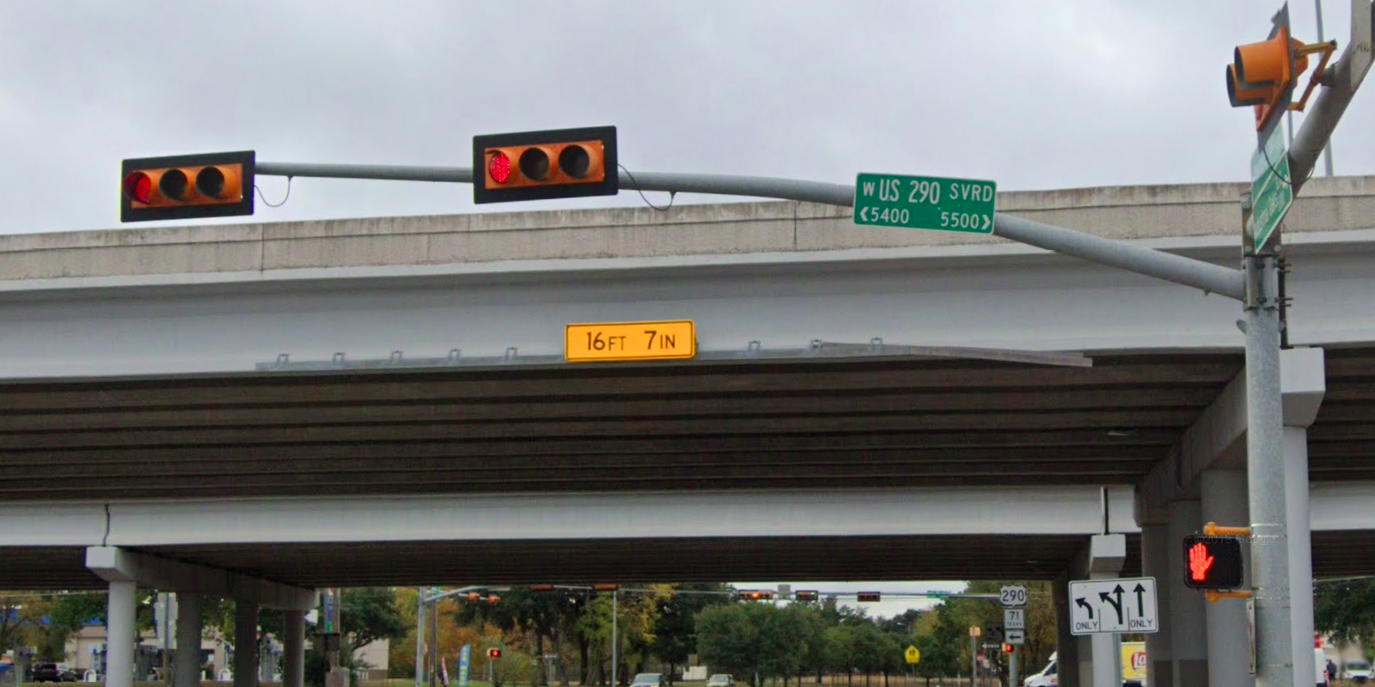
Austin Transportation Department Signs Work Orders
Created By: Susanne Gov Created Date: 2020-08-10 Location Name: US 290 HWY SVRD / INDUSTRIAL OAKS BLVD Intersection ID: 5147034 Cardinal Direction: S Work Order ID: SG-20710
Sign Type | Install/Remove
Street Name Sign | Install

Slide 3
Austin Transportation Department Signs Work Orders
Created By: Susanne Gov Created Date: 2020-08-10 Location Name: US 290 HWY SVRD / INDUSTRIAL OAKS BLVD Intersection ID: 5147034 Cardinal Direction: E Work Order ID: SG-20710
Sign Type | Install/Remove

Slide 4
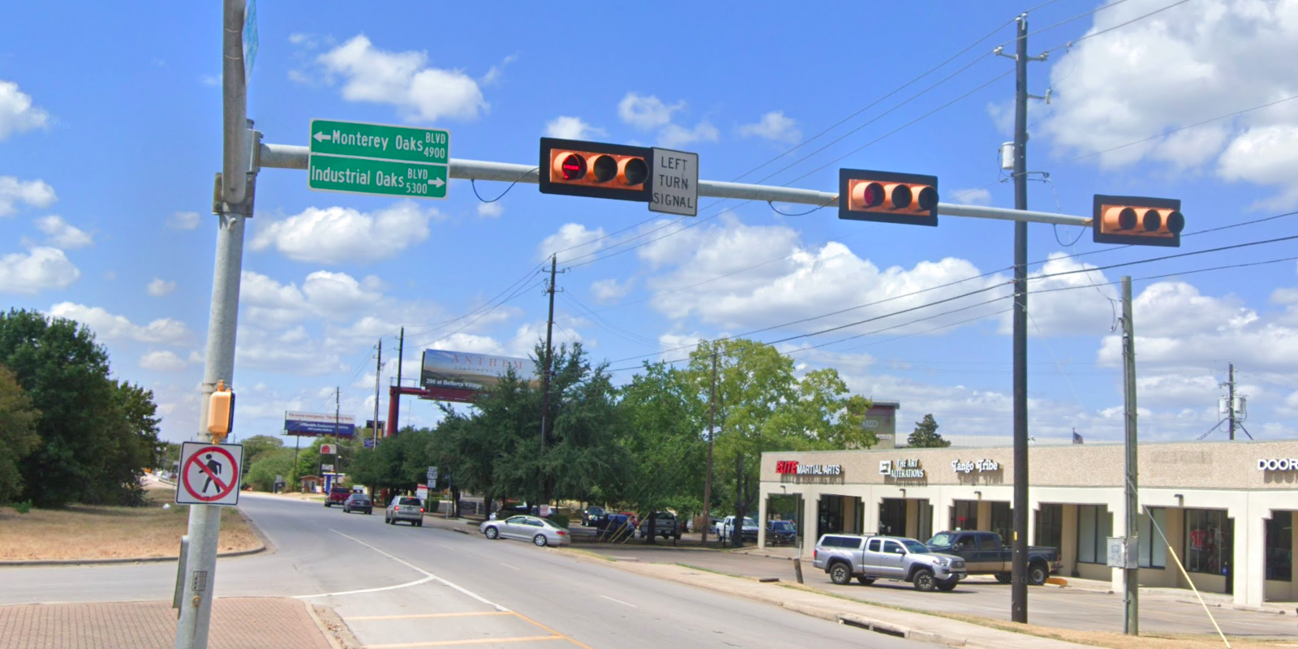
Austin Transportation Department Signs Work Orders
Created By: Susanne Gov Created Date: 2020-08-10 Location Name: US 290 HWY SVRD / INDUSTRIAL OAKS BLVD Intersection ID: 5147034 Cardinal Direction: W Work Order ID: SG-20710
Sign Type | Install/Remove
Left Turn Signal | Install
Street Name Sign | Install

